Slide 1
CS310 Operating Systems Lecture 12: Thread Implementation

Slide 2
References
Book: Operating Systems: Principles and Practice: Thomas Anderson and Michael Dahlin, Part 1 and Part 2
CS162, Operating Systems and Systems Programming, University of California, Berkeley
CS4410, Operating Systems, Course, Cornell University, Spring 2019, Lecture on Threads
Operating Systems: Three Easy Pieces, by Remzi and Andrea Arpaci-Dusseau, available for free online
Book: Modern Operating Systems, Andrew Tenenbaum, and Herbert Bos, 4th Edition, Pearson

Slide 3
Read the following:
Book: Operating Systems: Principles and Practice (2nd Edition) Anderson and Dahlin
Volume 2, Concurrency
Chapter 4: Concurrency and Threads
Book: Modern Operating Systems: Tenenbaum and Bos
Chapter 2: Processes and Threads

Slide 4
We have learnt so far ..

Slide 5
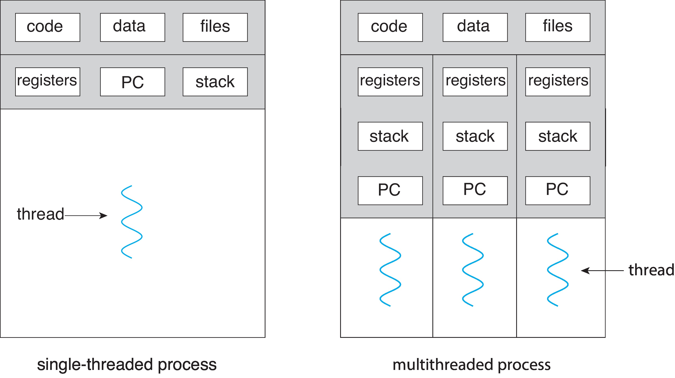
Recall: Single and Multithreaded Processes
Address
Space
Address spaces encapsulate protection: Passive Part
Threads share code, data, files, heap

Slide 6
Thread Abstraction

Slide 7
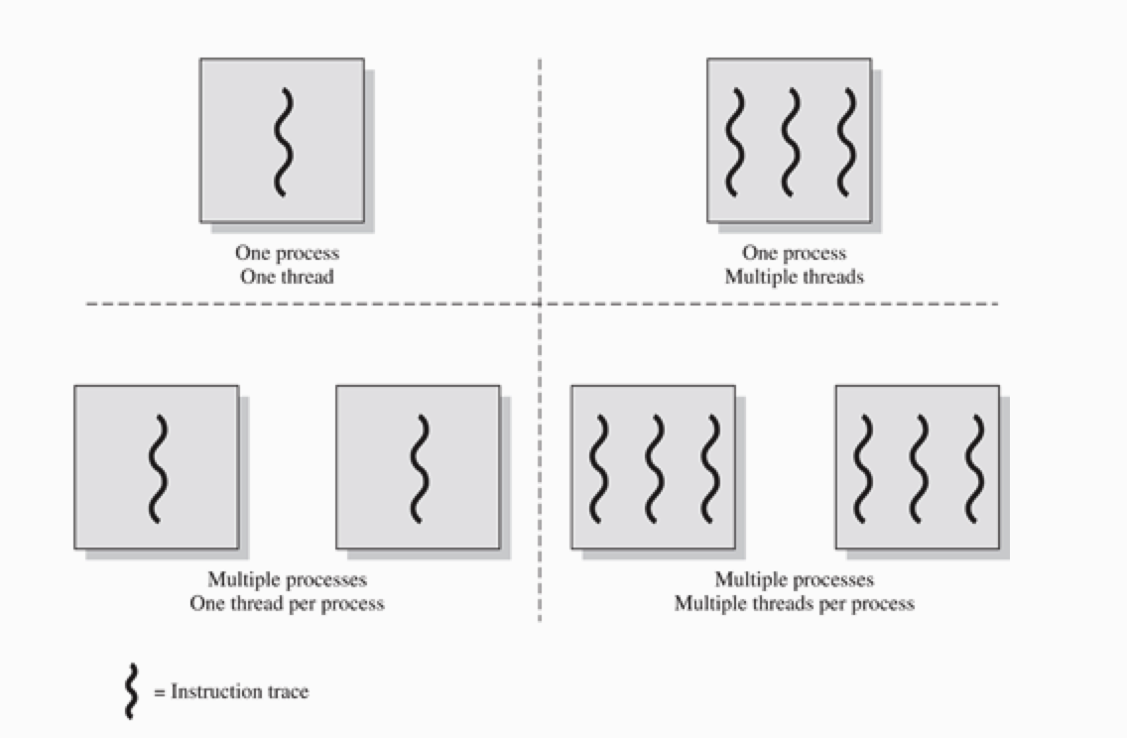
Source: OS book by Stallings

Slide 8
Recall: Why Threads?
To express a natural program structure
Updating the screen, fetching new data, receiving user input — different tasks within the same address space
To exploit multiple processors
Different threads may be mapped to distinct processors
To maintain responsiveness
Splitting commands, spawn threads to do work in the background
To mask long latency of I/O devices
Do useful work while waiting
Instead of waiting, the program may do something else
CPU can perform other computation, or
Threads are the natural way to avoid getting stuck
Why not processes instead of threads?
Threads are light weight: Share data and address space
Processes are sound choice when using logically separate tasks
CS4410 Cornell University

Slide 9
Recall: Why Threads?
Threads are lighter weight than processes
Easier to create and destroy than processes
Creating thread is 10-100 times faster than creating a process
Specially when the number of threads needed changes rapidly and dynamically,
Parallel programs must parallelize for performance
Programs with user interface need threading to ensure responsiveness
Network and disk bound programs use threading to hide network/disk latency
A multithreaded program is a generalization of the same basic programming model
Each individual thread follows a single sequence of steps (eg loops, call/return from functions, conditions etc)
A program can have several such threads in execution at the same time

Slide 10
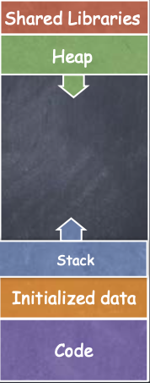
Recall: Thread
Process Address Space
All threads within a process share
Heap
Global/static data
Libraries
Each thread has a separate
Program Counter
Stack
registers
Any stack-allocated variables, parameters, re- turn values, and other things that we put on the stack
CS4410 Cornell University

Slide 11
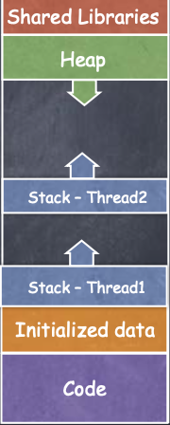
Recall: Threads
Process Address Space
All threads within a process share
Heap
Global/static data
Libraries
Each thread has a separate
Program Counter
Stack
registers
CS4410 Cornell University

Slide 12
Suspension and termination
Suspending a process involves suspending all threads of the process since all threads share the same address space
Termination of a process, terminates all threads within the process

Slide 13
Memory Footprint: Two-Threads
If we stopped this program and examined it with a debugger, we would see
Two sets of CPU registers
Two sets of Stacks
Questions:
How do we position stacks relative to each other?
What maximum size should we choose for the stacks?
What happens if threads violate this?
Stack 1
Stack 2
Address Space
Heap
Global Data
Code
Prof. John Kubiatowicz, CS 162, Operating Systems, UCB

Slide 14
In this class we will study
Thread Perspective
Process Vs Thread
Thread Life Cycle
Thread Implementation – Structures
User level thread - introduction

Slide 15
Thread Perspective Process Vs Thread

Slide 16
Thread Perspective
Thread’s
PC: keeps track of next instruction to be executed
Registers: holds current working variables
Execution Stack: contains execution history – one frame for each procedure called but not returned
Multithreading
Multiple threads per process
When a multithreaded process runs on a single CPU, the threads take turns running
Illusion of threads running in parallel (with fast context switching)
Different threads are not as independent as different processes
They share the same address space – share global variables – they can read, write, or even wipe out other thread’s stack
Adapted from Tenenbaum’s book: Modern Operating Systems

Slide 17
Threads must cooperate
There is no protection between threads (of a process)
Note that all threads belong to one process – no need for privacy – all threads of a process are owned by one user
While different processes may belong to different users
Threads must cooperate with each other (not fight)
Threads also share
the same set of open files
Child processes
Alarms and signals, and so on

Slide 18
Per-Process Items
(process properties)
Per-thread Items
(thread properties)
Address Space
Global Variables
Open files
Pending alarms
Signals and signal handler
Accounting information
Program Counter
Registers
Stack
State
If a thread opens a file, it is visible to all threads. They can read and write it
With thread, we are trying to achieve
Ability for multiple threads to share a set of resources so that they can work together closely to perform some tasks
Adapted from Tenenbaum’s book: Modern Operating Systems

Slide 19
Process
Thread
Have data/code/heap and other segments
Include at least one thread
If a process dies, its resources are reclaimed and its threads die
Inter-process communication via OS and data copying
Each process has its own address space; isolated from other processes’
Each process can run on a different processor
Expensive creation and context switch
No data segment or heap - specific to a thread
Needs to live in a process
More than one can be in a process.
If a thread dies, its stack is reclaimed
Inter-thread communication via memory
Have own stack and registers, but no isolation from other threads in the same process
Each thread can run on a different processor
Inexpensive creation and context switch

Slide 20
Processes Vs Threads
 | Process | Thread with a process
Overhead | Expensive to create (fork creates clone of a process) | low
Context Switching | Expensive | Context switch between two threads is low cost – swap basic CPU registers
Virtual Memory | All processes have their won page table | All threads have the same virtual memory
Security | High; Each process had diff address space | Less

Slide 21
Thread Life Cycle

Slide 22
Thread State
Thread’s
PC: keeps track of next instruction to be executed
Registers: holds current working variables
Execution Stack: contains execution history
State shared by all threads in process/address space
Content of memory (global variables, heap)
I/O state (file descriptors, network connections, etc)
State private to each thread
Kept in TCB (Thread Control Block)
CPU registers (including, program counter)
Thread’s Execution stack – to keep variables
Thread Metadata: Thread id, Owner, scheduling priority
Prof. John Kubiatowicz, CS 162, Operating Systems, UCB

Slide 23
Thread Life Cycle
Operating Systems Principles and Practice: Anderson and Dahlin

Slide 24
Thread Life Cycle
INIT State
Initializes and allocates per-thread data structure
READY State
Thread is available in ready list
It is available to be run but yet not scheduled
RUNNING State
Transition from READY to RUNNING by copying it’s register values from its TCB to the processor’s registers
Thread is running (executing) on the processor
Transitions possible to: READY state, WAITING state, or FINISHED state
Will discuss these
Operating Systems Principles and Practice: Anderson and Dahlin

Slide 25
Transition from Running State to Ready State
Preemption by Scheduler
OS saves the thread’s registers to it’s TCB
Switching the processor to run the next thread on the ready list
Voluntarily Relinquishing the Processor
By calling thread_yield in the thread library
Operating Systems Principles and Practice: Anderson and Dahlin

Slide 26
Waiting State and Finished State
WAITING State
Thread is waiting for some event
A thread in WAITING state is placed into READY state by another thread – once the event happens
Use of synchronization variable
Example: a thread will be in WAITING state by calling thread_join for it’s child
FINISHED State
A thread in the FINISHED state never runs again
System can free up some or all of it’s state (registers etc) for other uses
OS may keep TCB in finished list for some time
When a thread’s state is no longer needed (eg after exit value has been read by the join call), it is deleted
Operating Systems Principles and Practice: Anderson and Dahlin

Slide 27
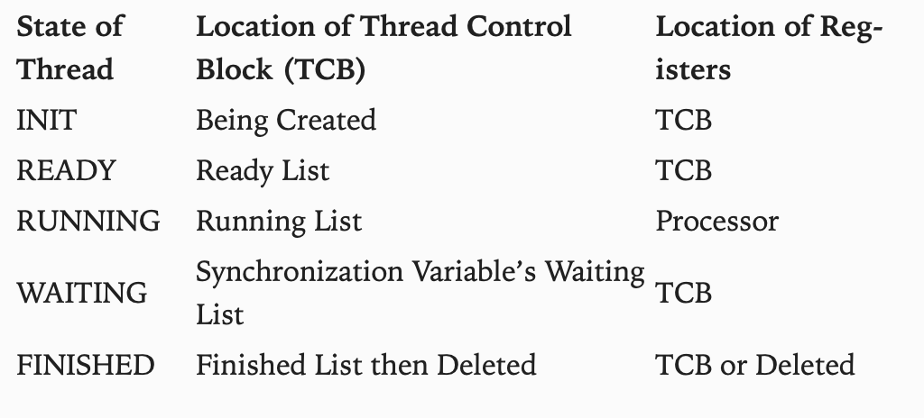
Location of thread’s per-thread state for different Life cycle stages
Operating Systems Principles and Practice: Anderson and Dahlin

Slide 28
Thread Implementation - Structures TCB and Execution Stack

Slide 29
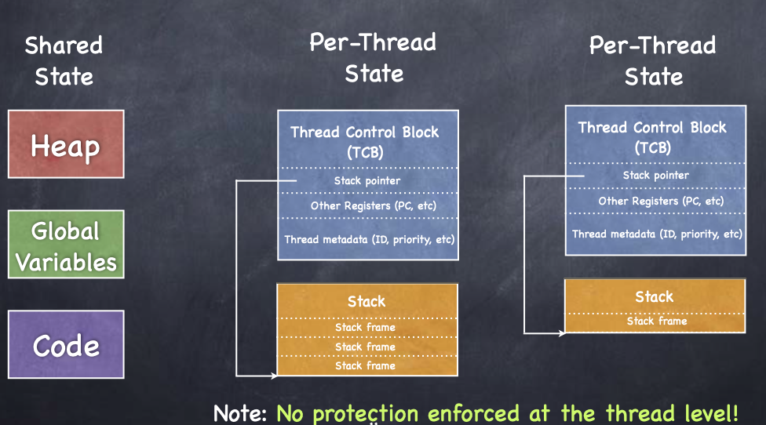
Implementing Thread Abstraction
CS4410 Cornell University

Slide 30
Thread’s Execution Stack
It is the same as that for the stack for a single-threaded (process) computation
Stores information needed by nested procedures – currently running
Example: if a thread calls foo(), foo() calls bar(), and bar() calls bas()
The stack will have stack frames for each of these procedures to store local variables and return address
Each thread has it’s own stack
When a new thread is created, the OS allocates a new stack and stores a pointer to that stack in the thread’s TCB
Each thread generally call different procedures and thus have different execution history
Operating Systems Principles and Practice: Anderson and Dahlin

Slide 31
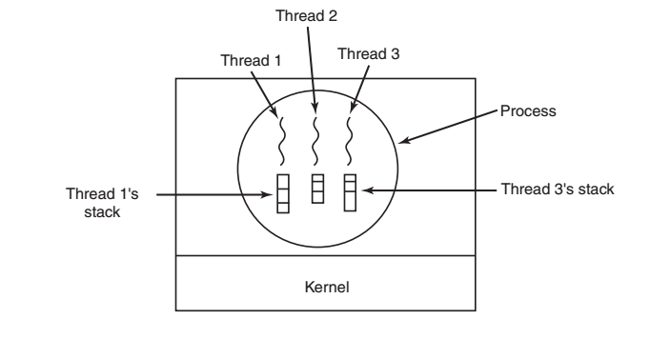
Each thread has its own execution stack
Each thread’s execution stack may have different frames corresponding to different procedures called by the thread
Adapted from Tenenbaum’s book: Modern Operating Systems

Slide 32
How big is a stack for each thread?
Stack grows and shrinks
The size of the stack should be large enough to accommodate the deepest nesting level allowed
Modern OS allocate
Kernel stacks (for each thread)
Nesting depth is usually small (in Kernel threads)
Linux allocates 8KB stack to each kernel thread
User level stacks in Virtual Memory
No need for tight space constraints
Often 1MB

Slide 33
Backup

Slide 34
Recall - how Execution Stack works? (from Computer Architecture course)

Slide 35
Execution Stack Example
A(int tmp) {
if (tmp<2)
B();
printf(tmp);
}
B() {
C();
}
C() {
A(2);
}
A(1);
A:
A+1:
A+2:
B:
B+1:
C:
C+1:
exit:
Stack holds temporary results
Permits recursive execution
Crucial to modern languages

Slide 36
Execution Stack Example
A: tmp=1
ret=exit
A(int tmp) {
if (tmp<2)
B();
printf(tmp);
}
B() {
C();
}
C() {
A(2);
}
A(1);
Stack
Pointer
A:
A+1:
A+2:
B:
B+1:
C:
C+1:
exit:
Stack holds temporary results
Permits recursive execution
Crucial to modern languages

Slide 37
Execution Stack Example
A: tmp=1
ret=exit
A(int tmp) {
if (tmp<2)
B();
printf(tmp);
}
B() {
C();
}
C() {
A(2);
}
A(1);
Stack
Pointer
A:
A+1:
A+2:
B:
B+1:
C:
C+1:
exit:
Stack holds temporary results
Permits recursive execution
Crucial to modern languages

Slide 38
Execution Stack Example
A: tmp=1
ret=exit
A(int tmp) {
if (tmp<2)
B();
printf(tmp);
}
B() {
C();
}
C() {
A(2);
}
A(1);
Stack
Pointer
A:
A+1:
A+2:
B:
B+1:
C:
C+1:
exit:
Stack holds temporary results
Permits recursive execution
Crucial to modern languages

Slide 39
Execution Stack Example
A: tmp=1
ret=exit
A(int tmp) {
if (tmp<2)
B();
printf(tmp);
}
B() {
C();
}
C() {
A(2);
}
A(1);
A:
A+1:
A+2:
B:
B+1:
C:
C+1:
exit:
B: ret=A+2
Stack
Pointer
Stack holds temporary results
Permits recursive execution
Crucial to modern languages

Slide 40
Execution Stack Example
A: tmp=1
ret=exit
A(int tmp) {
if (tmp<2)
B();
printf(tmp);
}
B() {
C();
}
C() {
A(2);
}
A(1);
A:
A+1:
A+2:
B:
B+1:
C:
C+1:
exit:
B: ret=A+2
Stack
Pointer
Stack holds temporary results
Permits recursive execution
Crucial to modern languages

Slide 41
Execution Stack Example
A: tmp=1
ret=exit
A(int tmp) {
if (tmp<2)
B();
printf(tmp);
}
B() {
C();
}
C() {
A(2);
}
A(1);
A:
A+1:
A+2:
B:
B+1:
C:
C+1:
exit:
B: ret=A+2
C: ret=B+1
Stack
Pointer
Stack holds temporary results
Permits recursive execution
Crucial to modern languages

Slide 42
Execution Stack Example
A: tmp=1
ret=exit
A(int tmp) {
if (tmp<2)
B();
printf(tmp);
}
B() {
C();
}
C() {
A(2);
}
A(1);
A:
A+1:
A+2:
B:
B+1:
C:
C+1:
exit:
B: ret=A+2
C: ret=B+1
A: tmp=2
ret=C+1
Stack
Pointer
Stack Growth
Stack holds temporary results
Permits recursive execution
Crucial to modern languages

Slide 43
Execution Stack Example
A: tmp=1
ret=exit
A(int tmp) {
if (tmp<2)
B();
printf(tmp);
}
B() {
C();
}
C() {
A(2);
}
A(1);
A:
A+1:
A+2:
B:
B+1:
C:
C+1:
exit:
B: ret=A+2
C: ret=B+1
A: tmp=2
ret=C+1
Stack
Pointer
Stack Growth
Output:
>2
Stack holds temporary results
Permits recursive execution
Crucial to modern languages

Slide 44
Execution Stack Example
A: tmp=1
ret=exit
A(int tmp) {
if (tmp<2)
B();
printf(tmp);
}
B() {
C();
}
C() {
A(2);
}
A(1);
A:
A+1:
A+2:
B:
B+1:
C:
C+1:
exit:
B: ret=A+2
C: ret=B+1
A: tmp=2
ret=C+1
Stack
Pointer
Stack Growth
Output:
>2
Stack holds temporary results
Permits recursive execution
Crucial to modern languages

Slide 45
Execution Stack Example
A: tmp=1
ret=exit
A(int tmp) {
if (tmp<2)
B();
printf(tmp);
}
B() {
C();
}
C() {
A(2);
}
A(1);
A:
A+1:
A+2:
B:
B+1:
C:
C+1:
exit:
B: ret=A+2
C: ret=B+1
Stack
Pointer
Output:
>2
Stack holds temporary results
Permits recursive execution
Crucial to modern languages

Slide 46
Execution Stack Example
A: tmp=1
ret=exit
A(int tmp) {
if (tmp<2)
B();
printf(tmp);
}
B() {
C();
}
C() {
A(2);
}
A(1);
A:
A+1:
A+2:
B:
B+1:
C:
C+1:
exit:
B: ret=A+2
Stack
Pointer
Output:
>2
Stack holds temporary results
Permits recursive execution
Crucial to modern languages

Slide 47
Execution Stack Example
A: tmp=1
ret=exit
A(int tmp) {
if (tmp<2)
B();
printf(tmp);
}
B() {
C();
}
C() {
A(2);
}
A(1);
Stack
Pointer
A:
A+1:
A+2:
B:
B+1:
C:
C+1:
exit:
Output:
>2 1
Stack holds temporary results
Permits recursive execution
Crucial to modern languages

Slide 48
Execution Stack Example
A: tmp=1
ret=exit
A(int tmp) {
if (tmp<2)
B();
printf(tmp);
}
B() {
C();
}
C() {
A(2);
}
A(1);
Stack
Pointer
A:
A+1:
A+2:
B:
B+1:
C:
C+1:
exit:
Output:
>2 1
Stack holds temporary results
Permits recursive execution
Crucial to modern languages

Slide 49
Execution Stack Example
A(int tmp) {
if (tmp<2)
B();
printf(tmp);
}
B() {
C();
}
C() {
A(2);
}
A(1);
Output:
>2 1
Stack holds temporary results
Permits recursive execution
Crucial to modern languages

